Slide 1
How to Create My Advocacy Story
Published by The Arc of the United States
Last updated January 24, 2024

Slide 2
Directions (Slide 1 of 2)
This PowerPoint can help you organize your advocacy story.
PowerPoint can be a helpful story tool.
It can remind you of what you want to say.
You can use it to write out what you want others to know.
You can also use it to share images or pictures about your story.
The next slide shares the parts of the story we will discuss.

Slide 3
Directions (Slide 2 of 2)
Parts of Your Advocacy Story:
Who You Are
What’s Your Advocacy Goal
Why Your Goal Matters
Share Your Story
Re-state Your Goal
Thank Your Audience
For each story part, we share an example of how Edward used the guidance to put together a story. We also share his whole story at the end. Edward’s story is an example. He is not a real person. But his story is one that many people have.

Slide 4
Part 1: Who You Are
Share a photo of yourself or something important to your story, if it fits.
Tell people:
Where you live (city and state).
How you are a part of the disability community. For example, I am a person who has a disability or a family member.
About your disability and what it means to you.
Any other identities, like race or gender, that are important to you that you want to share.

Slide 5
EXAMPLE: About Me
My name is Edward.
I’m 35 years old.
I live with my mom in Falls Church, Virginia.
I have intellectual disability.
This means that it sometimes takes a bit longer for me to do or understand things.
Sometimes people don’t think I can do things.
They are WRONG!
I work at McDonalds.
I am a member of my local church.
I play rugby on a local inclusive team.

Slide 6
Part 2: What’s Your Advocacy Goal?
What is the most important problem that you face?
What change can be made to help you overcome this problem?

Slide 7
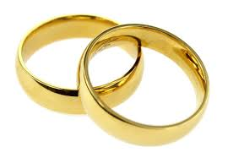
EXAMPLE: We Must End Marriage Penalties!
I have a girlfriend, and I want to marry her one day.
But, if I do, I will lose my Medicaid and Social Security.
These are very important to me.
They help me get the health care I need.
They help me have someone to help me make food and get around my neighborhood.
They help me pay for my apartment.
I need your help to vote to end the SSI asset limit marriage penalty and to support future legislation that will end all the marriage penalties disabled people face.

Slide 8
Part 3: Why Your Advocacy Goal Matters
How would achieving your goal change your daily life?
How would it make your life better?

Slide 9
EXAMPLE: Why Getting Married Matters
My girlfriend and I have been together for 8 years.
Our provider agency won’t let us live together because we are not married.
We can’t celebrate in front of our friends.
We can’t stand up in church as a married couple.
I have cousins who I have seen get married.
I want to also have this opportunity.
I love my girlfriend as much as they love their husbands and wives.
I imagine us living together, watching TV together, having pets and kids.
It is not fair to make me choose between the help I need and the person I love.

Slide 10
Part 4: Share your Story
Remember: This should be a clear and short story about why your advocacy goal matters. You are not telling people about your whole life.
Share an important moment that shows how the problem impacts you.
This may be the:
First time you experienced the problem
Last time you experienced the problem
The worst thing that has happened because of the problem
A time someone went out of their way to help you because of the problem
Be clear and direct. Share things in a way that people can relate to.
Avoid using acronyms. Spell out any that you use.

Slide 11
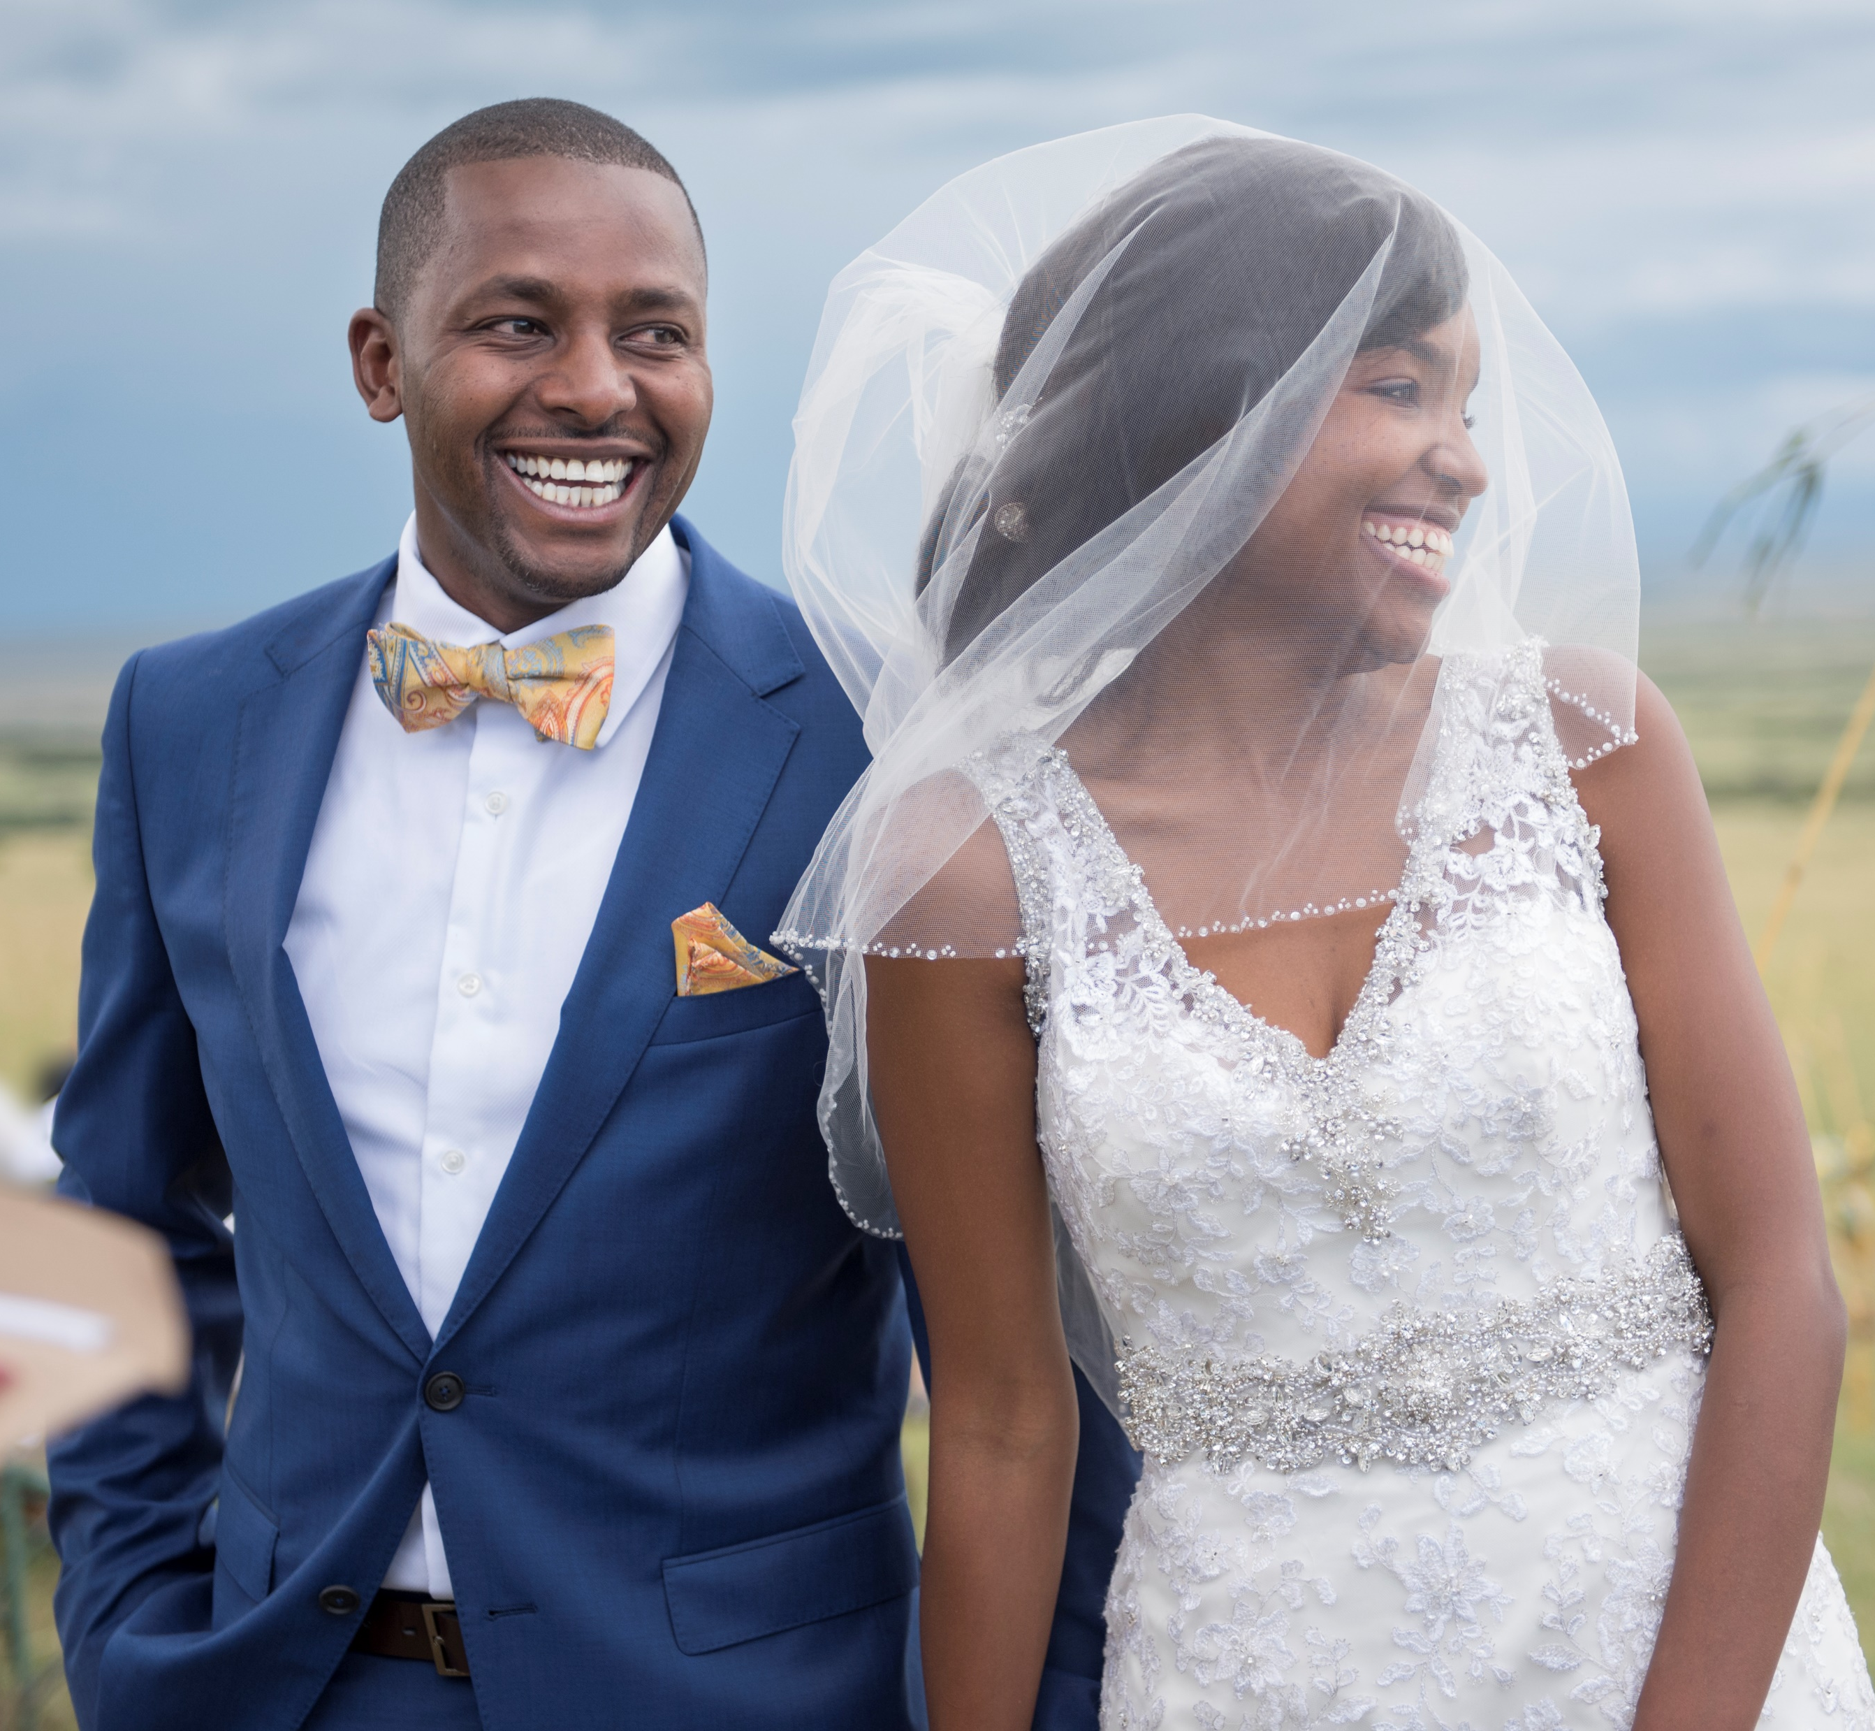
EXAMPLE: Carter and Zoe’s Wedding
My friends got married a few weeks ago.
Their wedding was beautiful.
I was so happy to be there.
But watching them get married made me sad.
It made me feel like it will never happen to me.
My girlfriend caught the bouquet.
That should make you happy.
But we both ended up crying because we know we can’t get married right now.
It’s hard to watch our friends have this relationship – and know we can’t have it.
I’m scared we will break up because of how sad it makes us every time we think about this.

Slide 12
Part 5: Re-state Your Advocacy Goal
Here is a sample sentence you could use to start: “I hope telling my story encourages you to …”
Share again the action you want them to take.
In 1-2 sentences share:
How it would help you
Why they should make this change
How it would help other people

Slide 13
EXAMPLE: Help Us End Marriage Penalties!
I hope that sharing my story encourages you to:
vote to end the SSI asset limit marriage penalty and
support future legislation that will end all the marriage penalties disabled people face.
It would mean the world to me and my girlfriend and thousands of other people around the country.
It would show us that people recognize that we can and are adults and that our love and faith are recognized and respected. It would give us the dignity to make these decisions as adults and members of our faith.

Slide 14
Part 6: Thank Your Audience
“Thank you for listening to me. We need your help and support!”
Saying thank you helps people know you value their time and support. It can help people be more willing to help.

Slide 15
EXAMPLE: Thank You!
Thank you for listening to me – and thank you for your support on this issue!
If you have any questions, please let me know.

Slide 16
EDWARD’S STORY PUT TOGETHER

Slide 17
About Me
My name is Edward.
I’m 35 years old.
I live with my mom in Falls Church, Virginia.
I have intellectual disability.
This means that it sometimes takes a bit longer for me to do or understand things.
Sometimes people don’t think I can do things.
They are WRONG!
I work at McDonalds.
I am a member of my local church.
I play rugby on a local inclusive team.

Slide 18
We Must End Marriage Penalties!
I have a girlfriend, and I want to marry her one day.
But, if I do, I will lose my Medicaid and Social Security.
These are very important to me.
They help me get the health care I need.
They help me have someone to help me make food and get around my neighborhood.
They help me pay for my apartment.
I need your help to vote to end the SSI asset limit marriage penalty and to support future legislation that will end all the marriage penalties disabled people face.

Slide 19
Why Getting Married Matters
My girlfriend and I have been together for 8 years.
Our provider agency won’t let us live together because we are not married.
We can’t celebrate in front of our friends.
We can’t stand up in church as a married couple.
I have cousins who I have seen get married.
I want to also have this opportunity.
I love my girlfriend as much as they love their husbands and wives.
I imagine us living together, watching TV together, having pets and kids.
It is not fair to make me choose between the help I need and the person I love.

Slide 20
Carter and Zoe’s Wedding
My friends got married a few weeks ago.
Their wedding was beautiful.
I was so happy to be there.
But watching them get married made me sad.
It made me feel like it will never happen to me.
My girlfriend caught the bouquet.
That should make you happy.
But we both ended up crying because we know we can’t get married right now.
It’s hard to watch our friends have this relationship – and know we can’t have it.
I’m scared we will break up because of how sad it makes us every time we think about this.

Slide 21
Help Us End Marriage Penalties!
I hope that sharing my story encourages you to:
vote to end the SSI asset limit marriage penalty and
support future legislation that will end all the marriage penalties disabled people face.
It would mean the world to me and my girlfriend and thousands of other people around the country.
It would show us that people recognize that we can and are adults and that our love and faith are recognized and respected. It would give us the dignity to make these decisions as adults and members of our faith.

Slide 22
Thank You!
Thank you for listening to me – and thank you for your support on this issue!
If you have any questions, please let me know.

Slide 23
QUESTIONS OR WANT TO SHARE YOUR STORY? EMAIL stories@thearc.org

