Slide 1

  WELCOME!
  Participants are currently in listen-only mode.
  You can communicate with other attendees or the host in the Chat Box and seek technical assistance if needed.
  You can type questions about the material presented in the Q&A section.
  Today’s webinar may be recorded and shared. Please keep this in mind when sharing information and experiences during the webinar.
  We understand this topic will generate many questions. However, due to the limited time we have, we may not get to every question in the Q&A portion.
Notes:
[Read slides]

Slide 2
The Arc@School’s Advocacy Curriculum – Spanish
Introduction
Notes:
Welcome to The Arc@School’s webinar, focused on introducing the launch of the Spanish-language Advocacy Curriculum. In this brief introductory webinar, you will learn about the core components of this curriculum. For those of you who are already familiar with the English version of the curriculum, the Spanish version is the exact same, just simply translated to Spanish.
This is the English language version of the webinar, if you are here by mistake and prefer the Spanish language version of the webinar that is scheduled to take place immediately after this webinar, at 1:30 ET. Please go to the link inserted in the chat box to register for that webinar.
DeeDee or Wanda read:
Esta es la versión en Inglés del seminario web, si está aquí por error y prefiere la versión en Español del seminario web que está programado para realizarse inmediatamente después de este seminario web, a las 2:00 ET. Vaya a en el chat para registrarse en ese seminario web.

Slide 3
History of the curriculum
English version launched in 2018
Thousands of users have accessed the curriculum
  Examples of the types of users include chapter staff, parents, caregivers, educators and advocates supporting families
2021 + 2022 – grant funded program supporting BIPOC and low-income households.
2023 + 2024 – grant funded program supporting rural states
Notes:
In 2018 The Arc@School launched the English version of the curriculum, funded through a grant from AT&T – we were very excited to provide this content to our chapter staff network and then realized that it would be greatly beneficial for families, educators and other disability advocacy professionals.
Since the launch, we’ve had thousands of users access the curriculum. Many of those users are chapter staff, but we also have many external users, such as parent or family members supporting a student with a disability, educators seeking more detailed information on special education federal law, also known as Individuals with Disabilities Education Act (IDEA) and other disability advocacy professionals.
In recent years we’ve partnered with various funders who have sponsored free accounts for differing demographics across the country. We’ve targeted specific regions, such as the rural south, as well as low-income households and BIPOC households.
We recognize the need for this information to be available in different languages and we’ve wanted to translate the curriculum to spanish for many years We are grateful that last year we received a grant to translate the entire curriculum, and that is what brings us here to today, to review the Spanish-version, talk about the features and how to get an account.

Slide 4
Intended Audience
Free
  Staff at Chapters of The Arc
$99 access fee (although some grant programs are available)
  Non-attorney advocates not affiliated with The Arc
  Parents and other family members
  Educators and related service providers
Notes:
Federal laws describe the services and supports available to students with disabilities, but students and parents often struggle to advocate on their own for appropriate educational services, and many seek help from a special education advocate. While both attorneys and non-attorney advocates are available to assist students and their families, non-attorney advocates are an important resource for students and families who cannot afford an attorney, find an attorney, or want to resolve their disagreements without involving an attorney.
This curriculum is designed for individuals who are working with or advocating on behalf of children with disabilities in special education matters, this training is also valuable for parents and other family members as well as educators and related disability professionals.
Chapter staff have free access to both the English and Spanish version of the curriculum, for everyone else there is a fee to access ($99), unless a chapter is running a grant-funded program that provides free access to their community.

Slide 5
Curriculum Content
Module 1: Building a Foundation for Advocacy
Module 2: IDEA and Early Intervention Services
Module 3: IDEA and Special Education Services
Module 4: Anatomy of an IEP
Module 5: Procedural Safeguards
Module 6: Section 504
Module 7: Educational Records
Module 8: Advocacy Skills
Notes:
If you are familiar with the curriculum this will be a refresher as I review the components.
The curriculum is online and self-paced. Users can work through content, pause and then come back to pick up where they left off.
The curriculum is comprised of 8 modules. Module 1 provides foundational knowledge needed for advocacy. Module 2 describes early intervention services. Module 3 provides an overview of special education services. Module 4 has a more in-depth discussion of individualized education programs, or IEPs. Module 5 describes parent’s rights, also known as procedural safeguards. Module 6 describes Section 504. Module 7 describes educational records. And module 8 talks about some of the basic advocacy skills a special education advocate needs.
Each module is roughly an hour long. All modules must be completed in order because the information provided in many modules lays the foundation for the following modules.
For example, many of the items that a user learns in Module 1 will be referenced later in the curriculum, so for that reason, users must complete the modules in order.

Slide 6
Module Features
Pre-test
Listening guide
Narrated video presentations
Post-test
Cultural competencies
Additional resources
Notes:
A pre-test, which is comprised of 10 multiple choice questions. The pre-tests measure the baseline of users prior knowledge, so users will not see how they did on the pre-test before moving onto the listening guide.
The listening guide can be downloaded and printed by users to use as a notetaking tool while listening to each module. We also offer the listening guide in a fillable pdf format. The listening guide will help users identify the important concepts in each module.
Each module has anywhere between 4 and 7 short, narrated videos, which average around 10 minutes each. The videos have been broken into small portions so that users can have the freedom to stop and start working on the curriculum at their convenience.
When the user completes all of the recorded videos, the user will take the post test, which is comprised of 10 multiple choice questions. In order to pass the test and move on to the next module, users will need to get at least 8 out of the 10 questions correct. Users have 3 total attempts to pass the post-test. The system requires users to wait 24 hours between attempts. The system will provide explanations on why the user’s responses are correct or incorrect to help the user better understand the module.
In 2021 The Arc@School added a new resource to each module. This resource is called cultural competencies, and it directly focuses on things that parents and advocates should be aware of related to bias, culture and race when supporting students of all backgrounds in special education. Our hope was to ensure that a whole-child approach is being taken when supporting a student’s intersecting identities.
Once the user passes the post-test, additional resources are provided at the end of each Module. Some of these resources are printable materials and some are links to online resources.

Slide 7
Additional Notes
Certificate of completion
6 months to complete the curriculum (some flexibility with timeline)
Permanent access to the curriculum materials upon completion
Send questions through the platform or directly to School@thearc.org
Notes:
It is important to note that…
Users who complete all 8 modules will receive a certificate of completion. This certificate states that the user has spent approximately 10 hours working on 8 major topics of special education advocacy. Users will receive a follow up email providing them with a certificate of completion.
The certificate of completion cannot guarantee earning of continuing education credits, because every state, school district, and professional organization has its own standards and requirements. Contact your state education agency, local school district, or professional organization to determine whether the curriculum will be accepted for professional development.
All users have 6 months from the date of account creation to complete the curriculum. Chapters can request an additional 3 months at no cost.
Because user accounts are not permanent in this learning platform, users who complete the curriculum will be given access to a printable version of the curriculum materials on The Arc@School’s website. You will receive directions for accessing those materials when you complete the curriculum.
If users need support they can reach out to school@thearc.org or send a message directly in the platform and we will receive an email with your request.

Slide 8
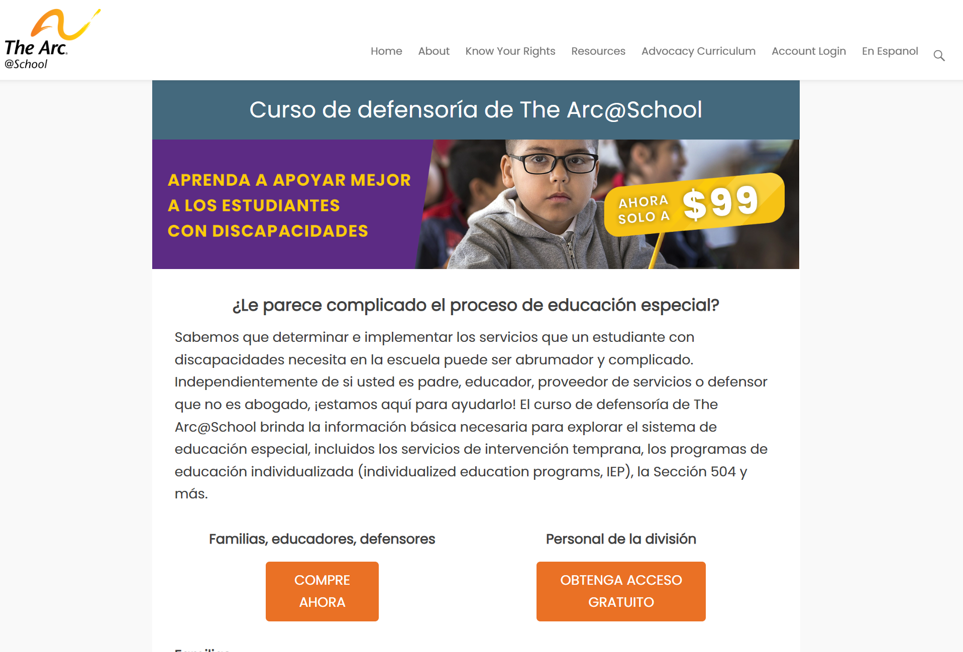
How to get an account
https://thearcatschool.org/advocacy-curriculum/
Notes:
Here is the Spanish curriculum information webpage – the page contains a summary of the curriculum, the resources in it and frequently asked questions
There are two ways to access the curriculum – paying users and chapter staff.
Paying users will be routed through the purchase form – the button on the left.
Chapter staff have free access and can request an account, we double check all chapter staff requests to ensure they are actual employees at chapters.

Slide 9
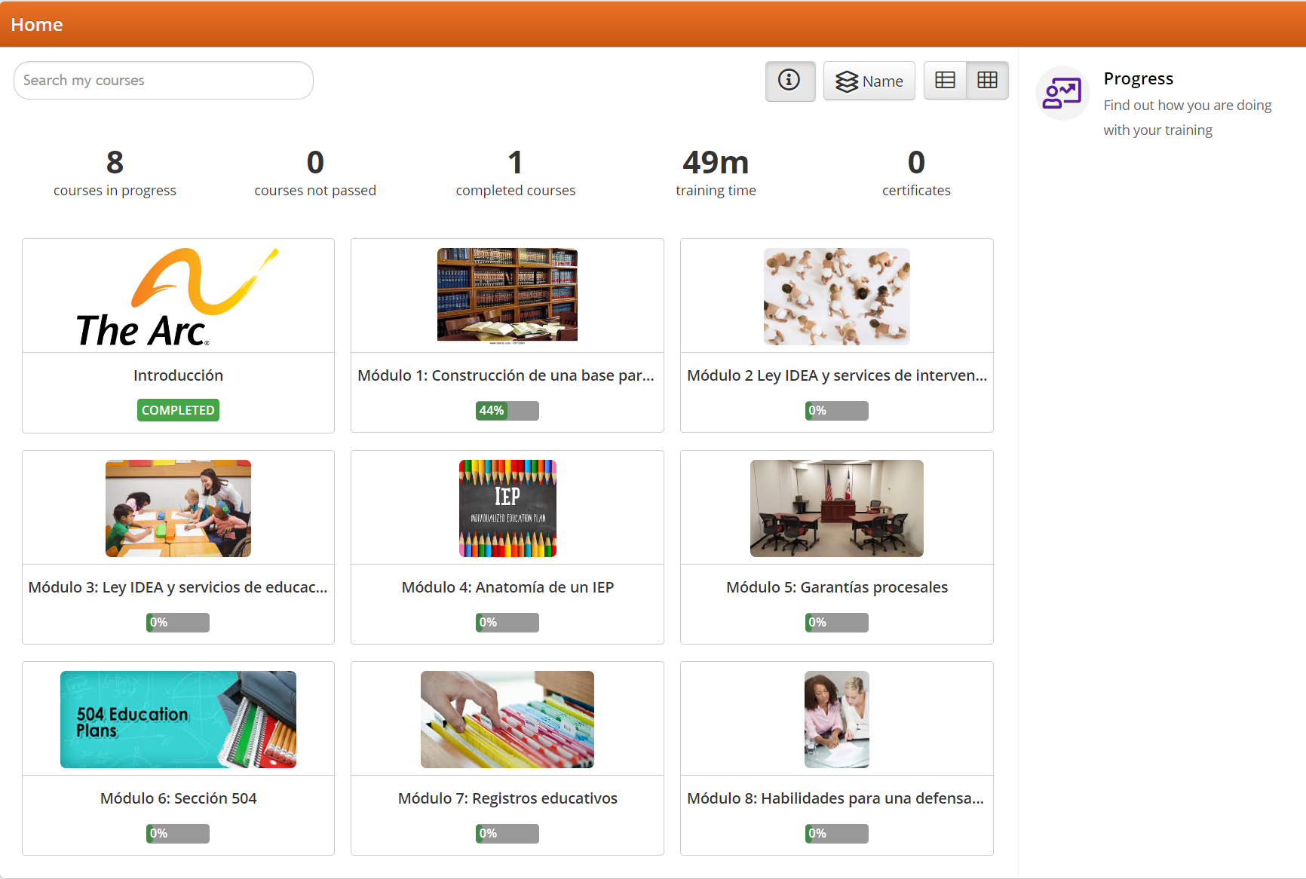
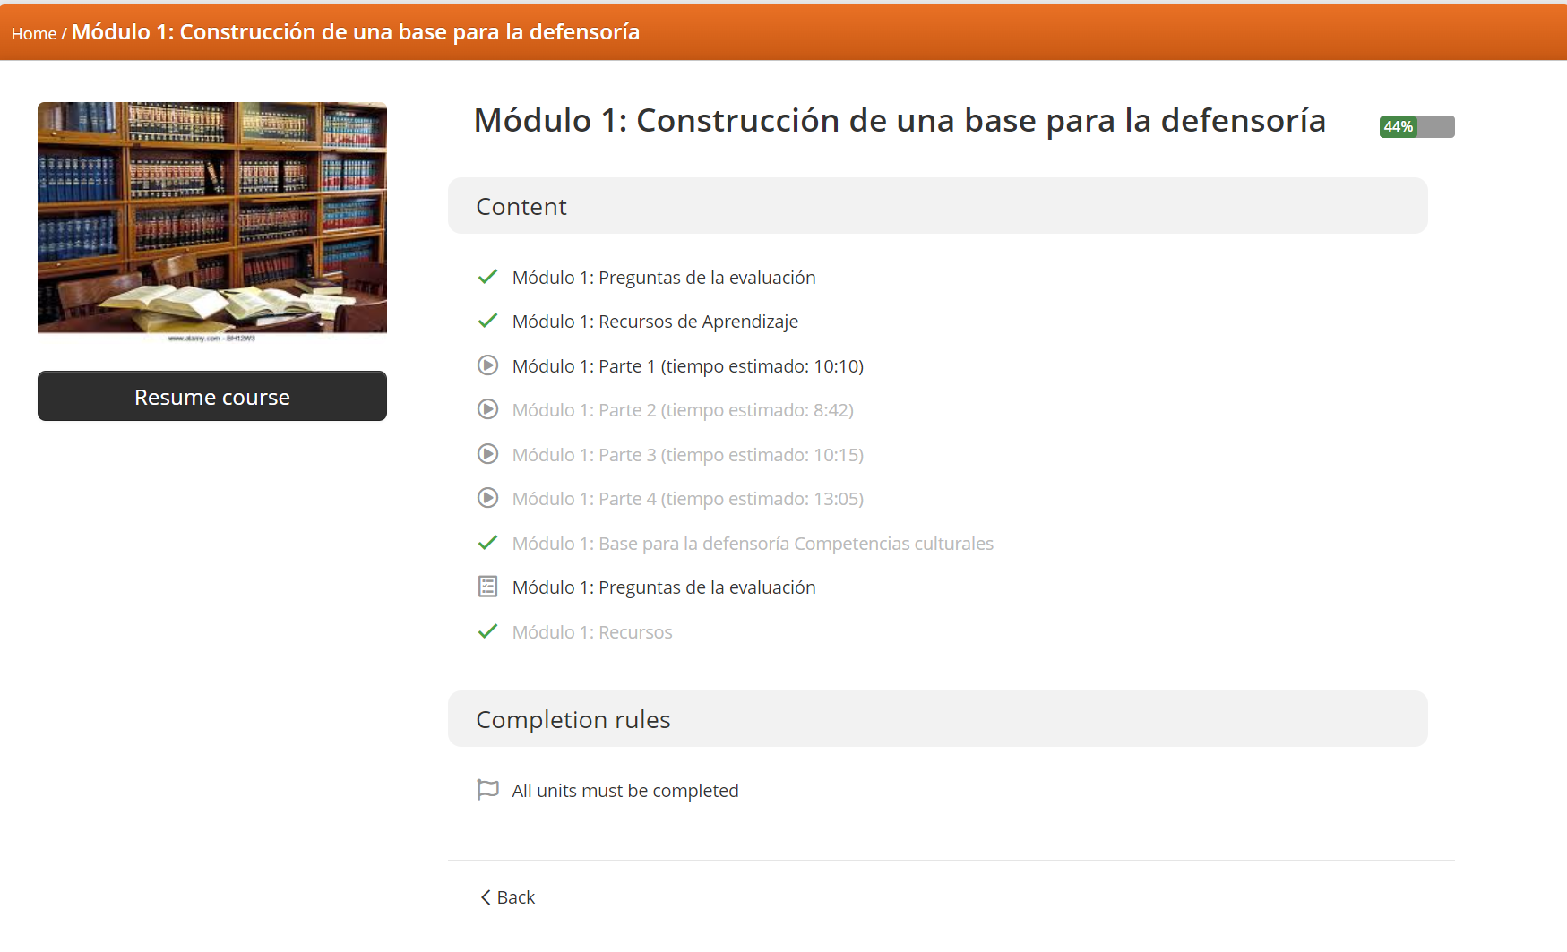
Talent LMS
Notes:
Upon receiving an account you will be provided with login credentials and instructions via email. Once you login, this is what the interface looks like. As I shared earlier there are 8 modules plus an introductory module.
Users must move through the content consecutively, meaning you must complete module 1 before moving on to module 2, since the content builds throughout the training.

Slide 10
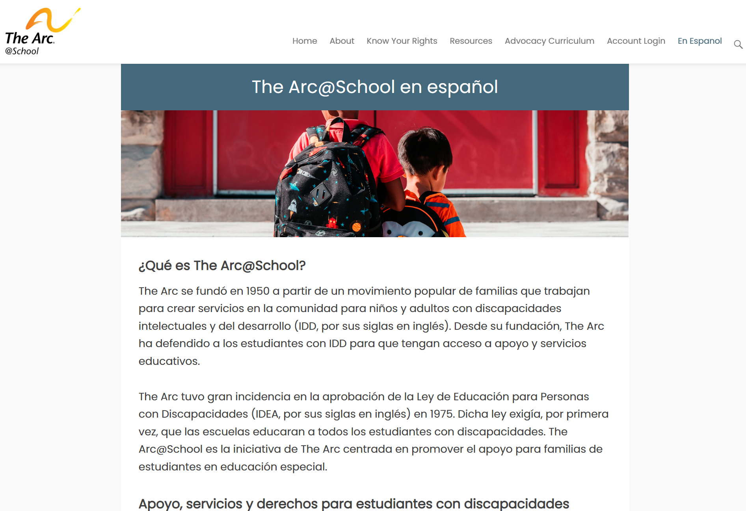
Additional resources
https://thearcatschool.org/en-espanol/
Notes:
For folks who are seeking basic, high level information on the special education process, we have a section of our website that is free and completely in Spanish.
Topics covered in that section include: general information on the special education process, Early Intervention, IEPs, Section 504, transition services.

Slide 11
Grant-funded free access
Currently we have a program that offers free access to the curriculum to users in southern rural states. Please reach out to school@thearc.org for more information.
  This program can be used to access both the English and Spanish curriculum.
There are other programs that exist as partnerships with chapters across the country you can reach out to school@thearc.org and we can let you know if there are any local-level programs.
Notes:
We do currently have a few grant-funded programs that provide free access to the curriculum. The first one is focused on providing free access to family members in southern rural states. We will provide information on that program in our follow up email to webinar attendees.
We also have several state-based partnerships with chapters who are working within their community to provide free access and host focus-groups to review the content, and discuss state and local special education nuances. Please email us to inquire if there is a program in your area.
If there isn’t a program right now, that doesn’t mean that there may not be one in the future, we are doing our best to target as many regions and states as possible when offering our grant-funded programming.

Slide 12
Questions?
School@thearc.org
THANK YOU

